Slide 1

Used Car Price Evaluator
Project Presentation

Slide 2


Submitted in partial fulfillment of the requirements for the award of degree of
BACHELOR OF TECHNOLOGY
IN
COMPUTER SCIENCE & ENGINEERING
Submitted to:
Assist. Prof. Dr. Vishan Kumar Gupta
Submitted By:
NAME (Enrollment No.)
Jayant Singh Jhala 20CS002272
Nitesh Agrawal 20CS002278
Jhalak Soni 21L3CS2294
DEPARTMENT OF COMPUTER SCIENCE & ENGINEERING
Sir Padampat Singhania University, Udaipur
April 2023

Slide 3
Index
1. Introduction
2. Background and Related work
3. Methodology
3.1. Data Exploration
3.2. Data Pre-Processing and Data Cleaning
3.3. Separating Categorical and Numerical Data
3.4. Conversion of Categorical Data into Numerical Data
4. Innovations in Project
5. Source Code
5.1. Source Code for HTML Website
5.2. Source Code for Random Forest Regression Model
6. Output
6.1. Sample Run
7. Result
8. Conclusion
9. Future Scope
10. Acknowledgement
11. Bibliography

Slide 4
1. Introduction
The prices of new cars in the industry is fixed by the manufacturer with some additional costs incurred by the Government in the form of taxes. But due to the increased price of new cars and the incapability of customers to buy new cars due to the lack of funds, used cars sales are on a global increase. [1]
Machine learning models have ever been a remarkable choice for prediction purposes and by training statistical models for predicting prices, one can get a certain estimate of the price. The number of studies that have explored this problem has also justified the prediction capability of the machine learning approach.[2]

Slide 5
2. Background and Related work
The study conducted by Ahtesham M. and Zulfiqar J. in [2] at Jinnah University for Women, has evaluated comparative performances of models including linear regression, Decision Tree Regression, and Gradient Boost tree regression to predict used car prices. The car price has a strong dependence on its variety of factors or attributes, and it helps to yield forecast accuracy for used car prices. The results of the research study show that the linear regression method has performed significantly less than the rest of the methods, which makes the model less preferable for price prediction. On the contrary, it is observed that linear regression has been extensively used in literature for prediction.

Slide 6
2. Background and Related work
In the research conducted by Laveena D’Costa, Ashoka Wilson D’Souza et al. in [3], has shown that the model that is created using this data can be used to predict the true value of used cars. The accuracy of the model was found to be 89.33%. The model is created using multiple linear regression and it provides good accuracy. The same data can be used to implement more algorithms and it may give accurate result.

Slide 7
2. Background and Related work
K Puteri and L N Safitri in their manuscript [4], had declared employing the variable age of use of cars in predicting the selling price of cars can be used as a reference to determine the price of used cars sold because it has a trust value of 63.2%. If using the car mileage variable only in predicting the selling price of the car only has a trust value of 33.2%. The selling price can also be predicted based on the age and distance of the used cars sold because of the trust value of 63.6%. To predict the selling price of cars with other additional variables namely age, distance, colours of cars, transmissions and cities car sales have a trust value of 76.2%.

Slide 8
3. Methodology
3.1. Data Exploration
The dataset of Car Dekho used in this research is taken from Kaggle. It is a massive data set that has about 19974 entries along with 13 features as given in Table1. The data set might contain null, unhandled, and unwanted values that need to be checked and verified before training the dataset for model development. The data set contains the Car Name along with its different features such as Model Year, Mileage, Transmission Type, etc.

Slide 9
3. Methodology
3.2. Data Pre-Processing and Data Cleaning
It is one of the most crucial steps that must be performed before the implementation phase. It refers to identifying and correcting errors in the data set that might negatively affect the predicting model. It includes all kinds of activities that help in detecting and repairing errors. In this procedure, we removed the rows that holds missing values and also dropped the features or attributes that might not be effective. Only those features are kept that are most important and strongly correlated. After data pre-processing, we were left with 7 features.

Slide 10
3. Methodology
3.3. Separating Categorical and Numerical Data
The dataset we are using contains both categorical and numerical values as found by us. The numerical features are separated from the categorical ones including New Price, Fuel Type, Transmission Type and others.

Slide 11
3. Methodology
3.4. Conversion of Categorical Data into Numerical Data
Most machine learning algorithms are unable to handle categorical data unless we convert them to numerical values to make it more machine understandable. The Dataset obtained after preprocessing is described as all numerical data type.

Slide 12
4. Innovations in Project
This system of used car price prediction provides better accuracy than the ones present in current studies, especially in context of Indian consumers
There is also no need for an individual to call a mechanic or visit a car evaluation service centre to evaluate their car for resale value nor should they be required to sell it to the showrooms for lower prices.

Slide 13
4. Innovations in Project
Thereby, resulting in saving time and money spent on hiring a service for evaluation and travel required to do so.
The innovative target of the project is that every option to enter detail must require minimalistic details from user and utilizing picklist when necessary with one click evaluation or prediction as defined in machine learning.

Slide 14
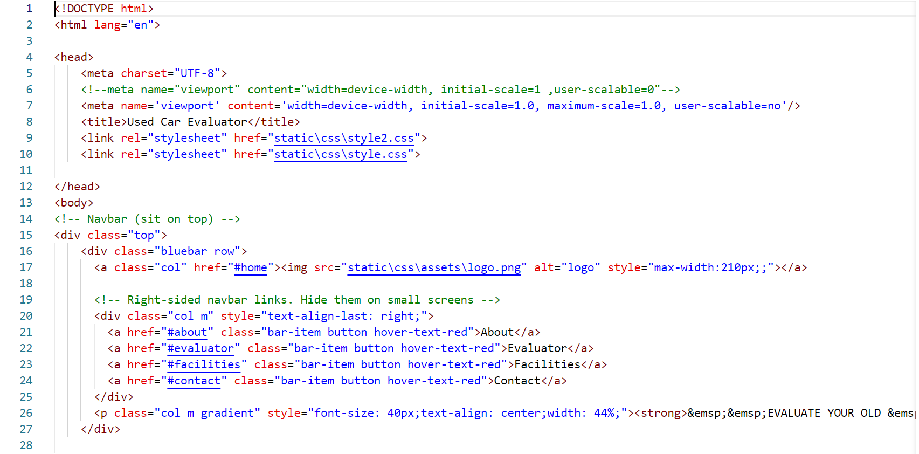
5. Source Code
5.1. Source Code for HTML Website

Slide 15
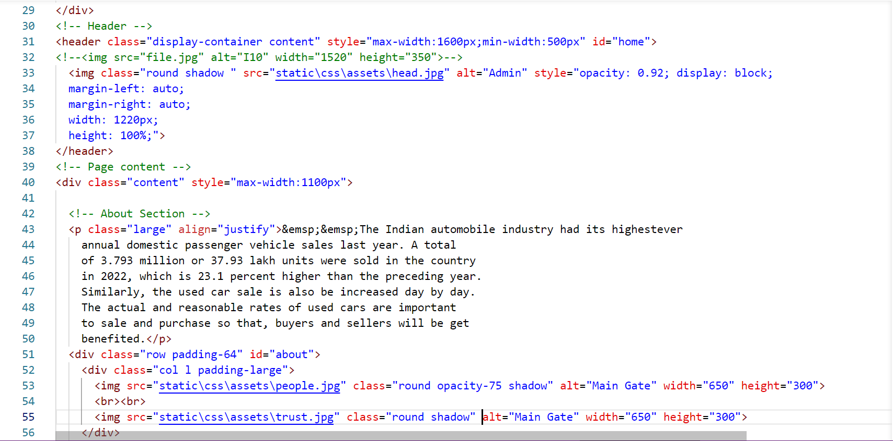

Slide 16
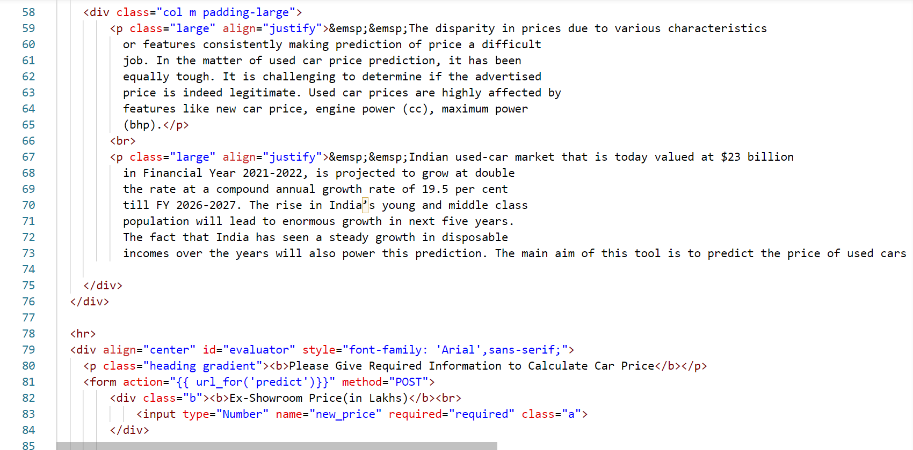

Slide 17
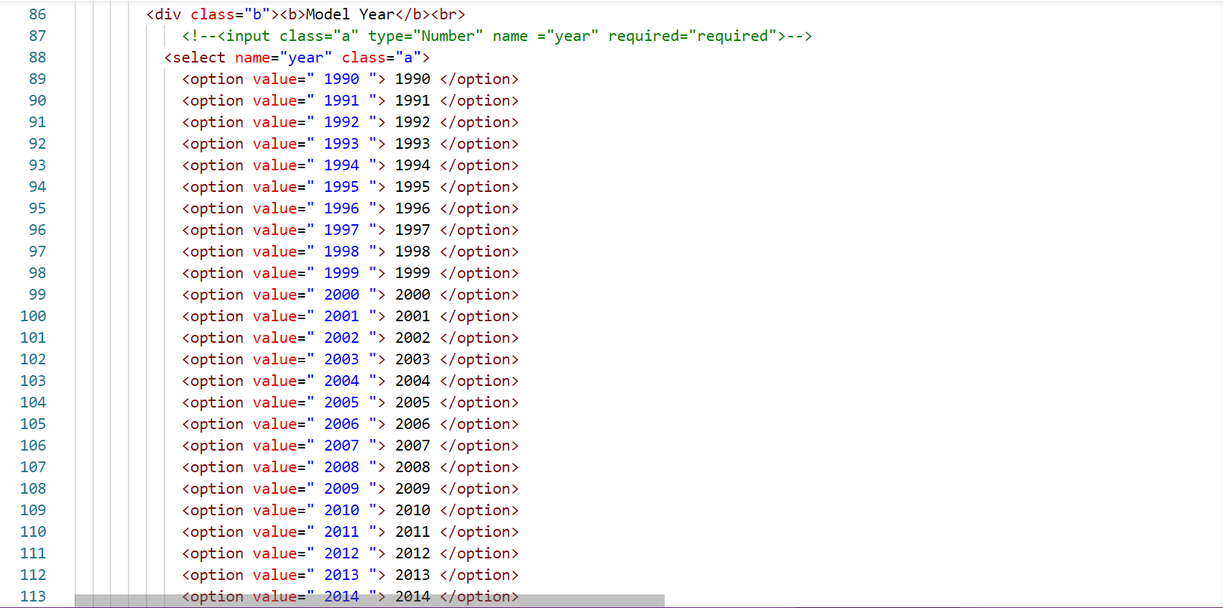

Slide 18
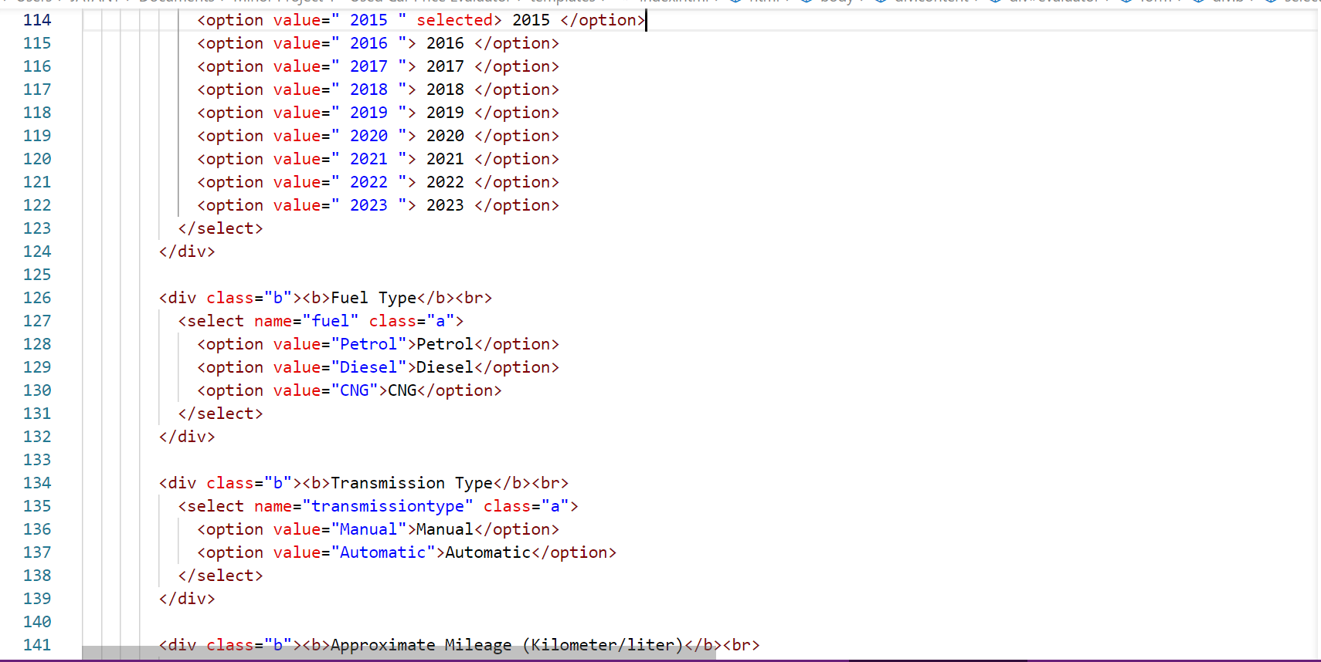

Slide 19
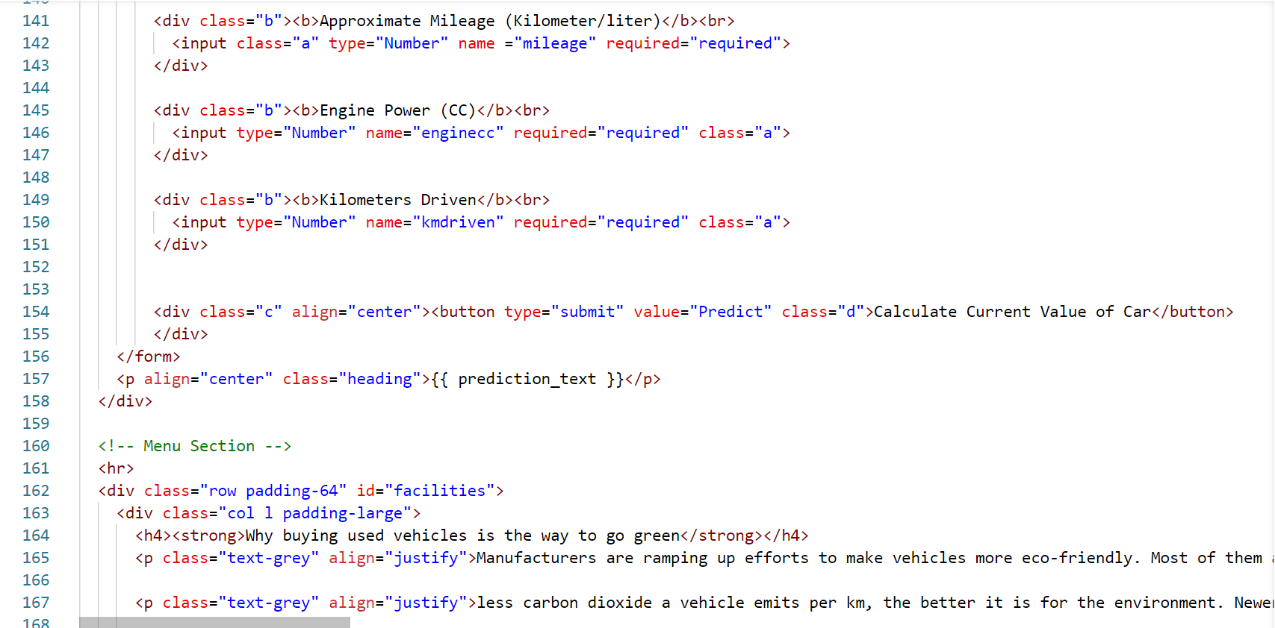

Slide 20
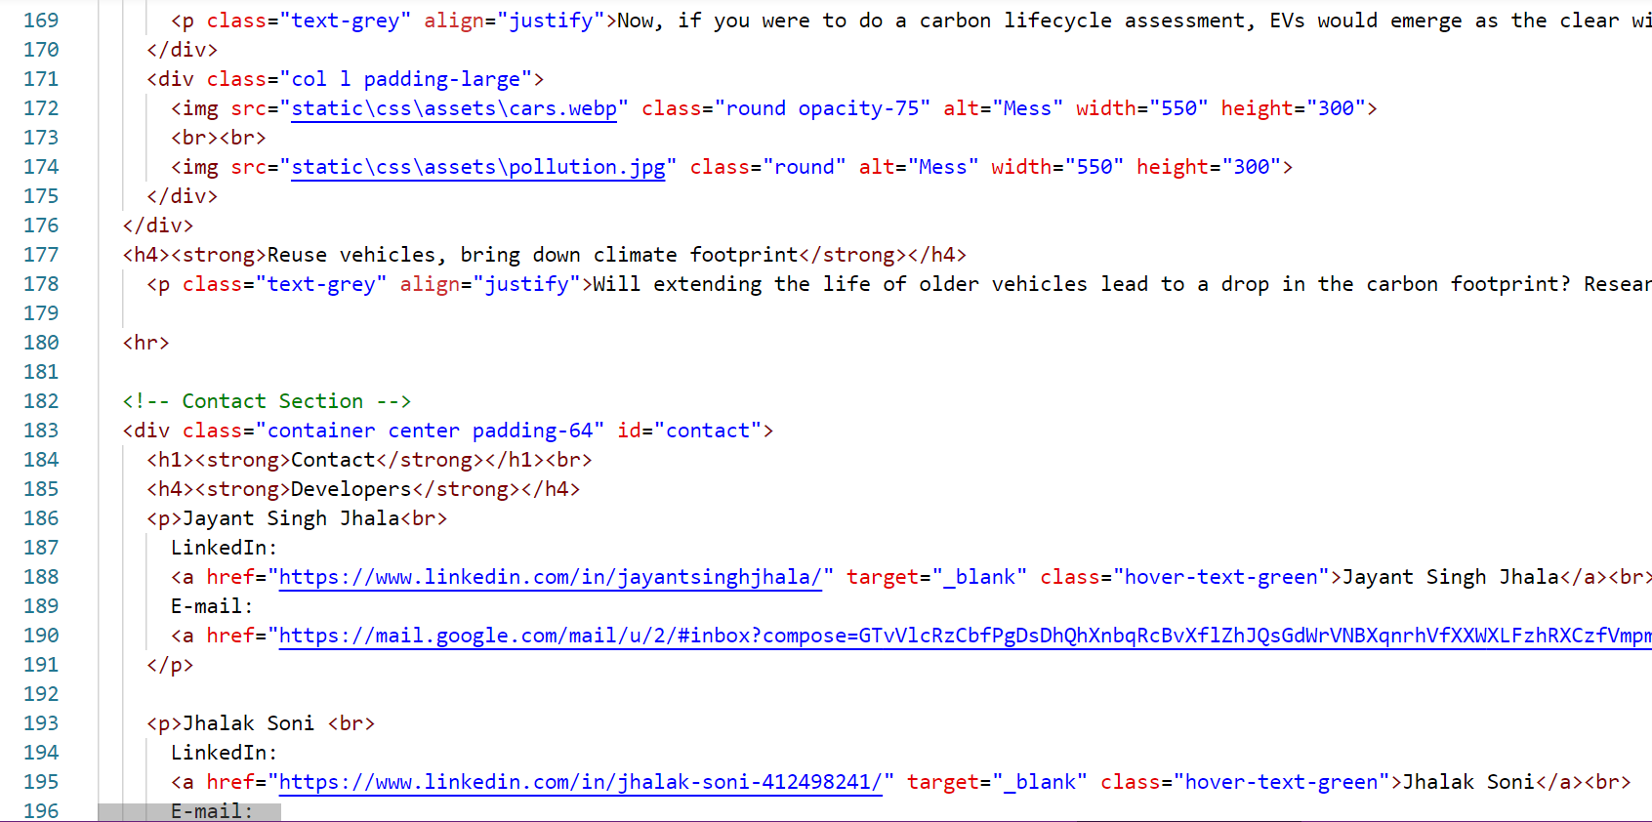

Slide 21
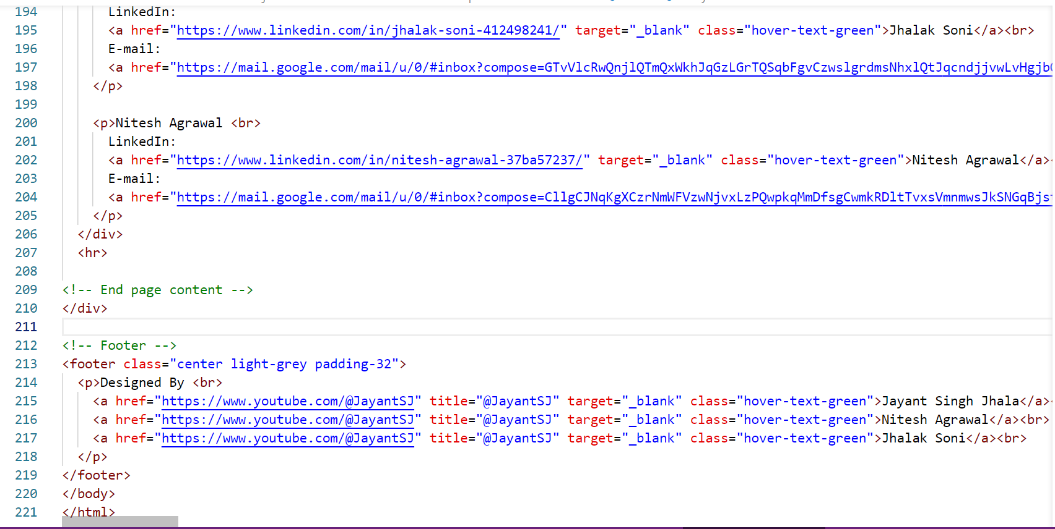

Slide 22
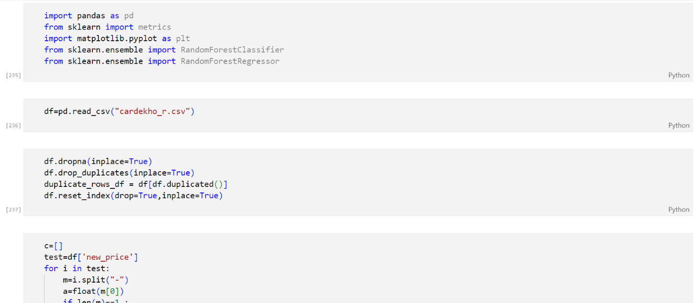
5.2. Source Code For Random Forest

Slide 23
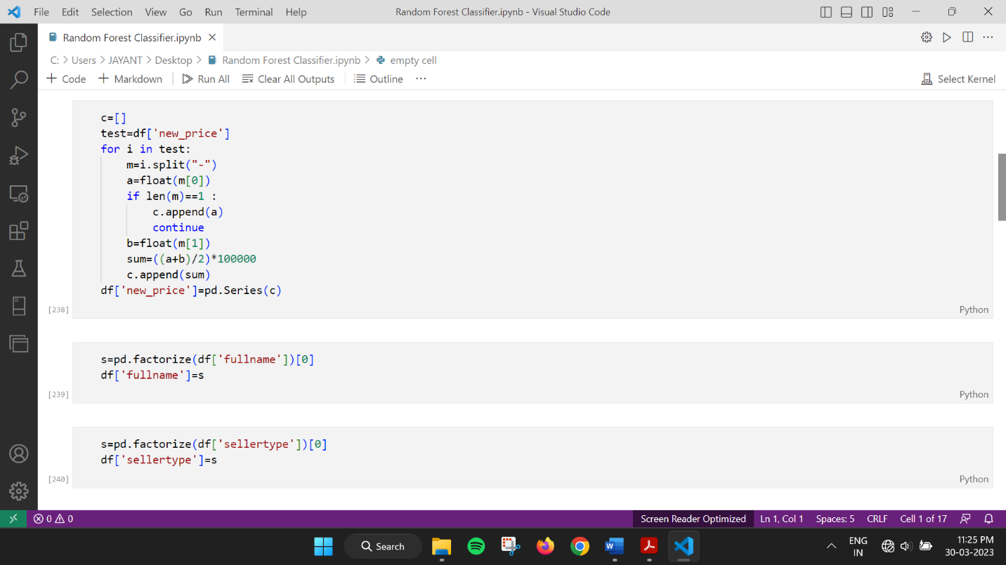

Slide 24
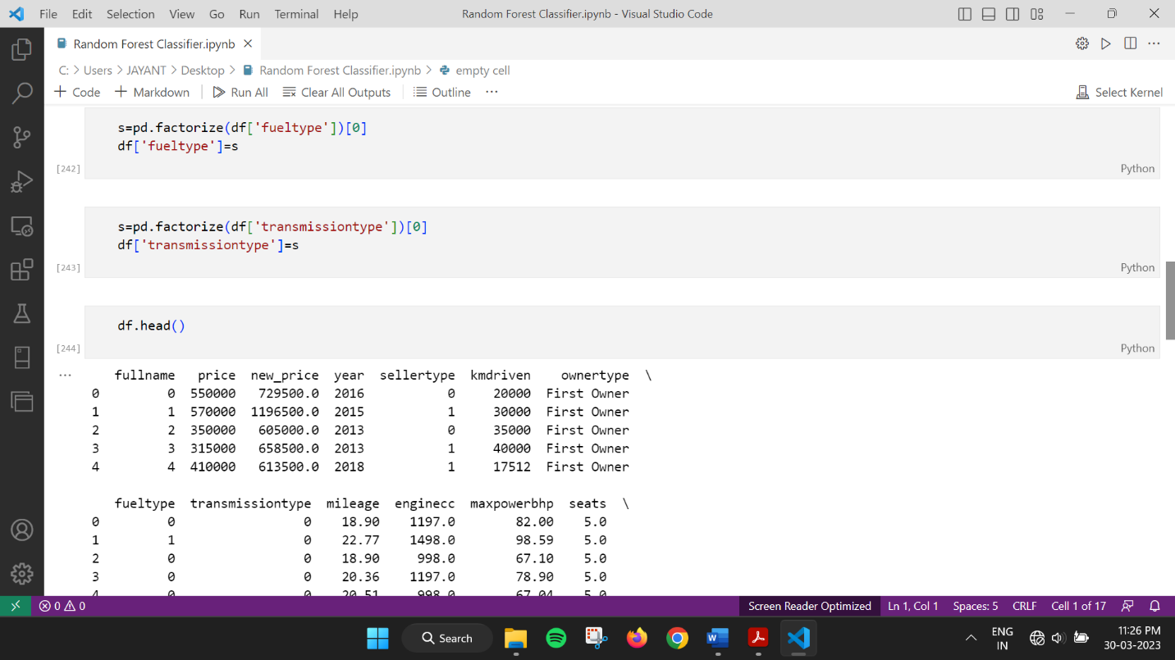

Slide 25
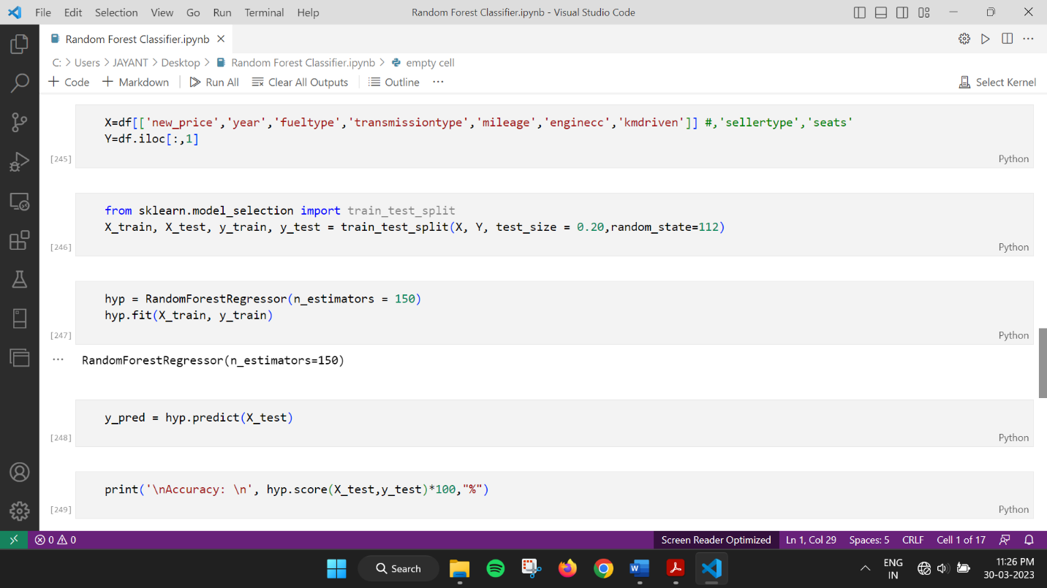

Slide 26
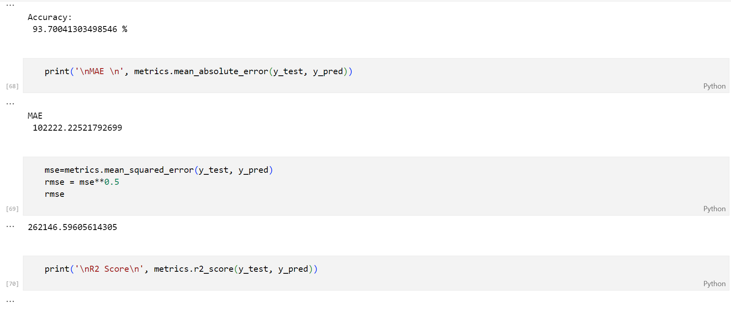

Slide 27
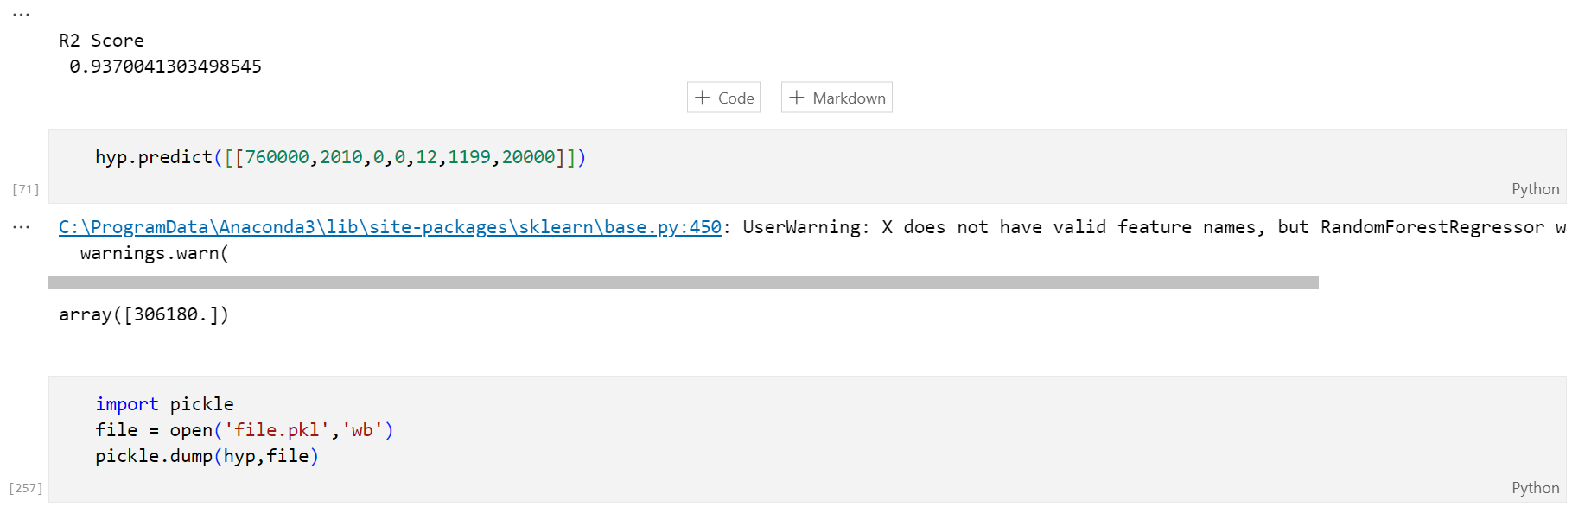

Slide 28
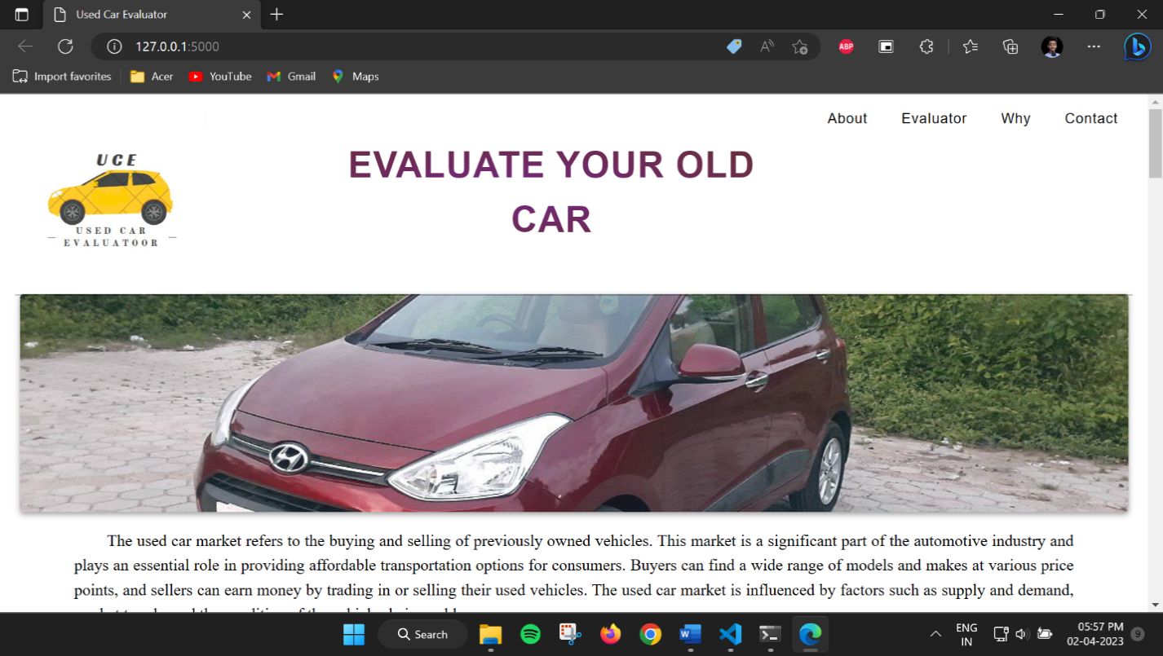
6. Output

Slide 29
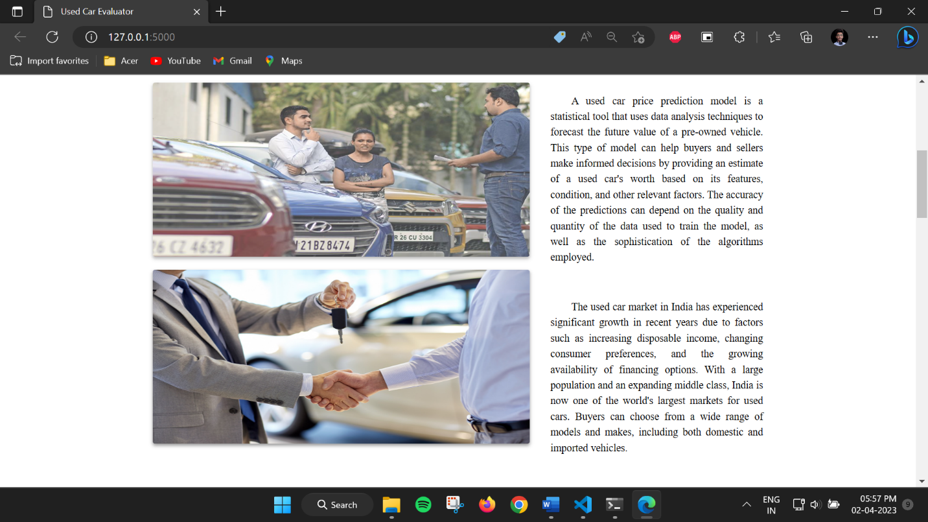

Slide 30
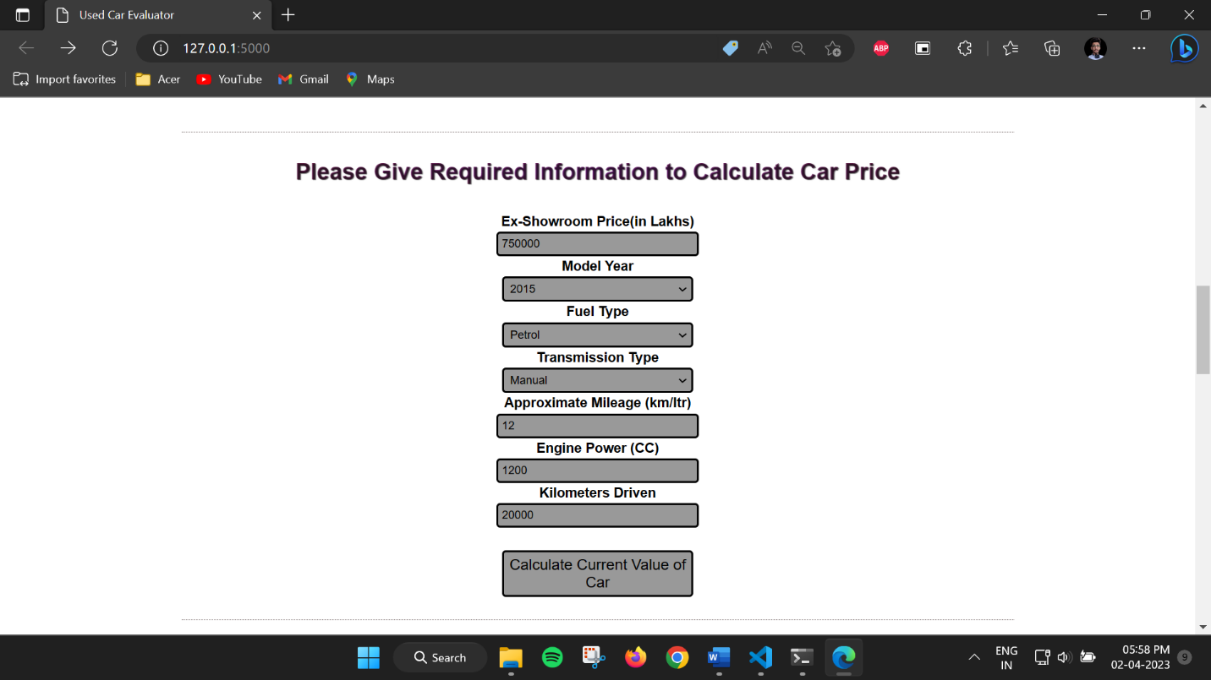

Slide 31
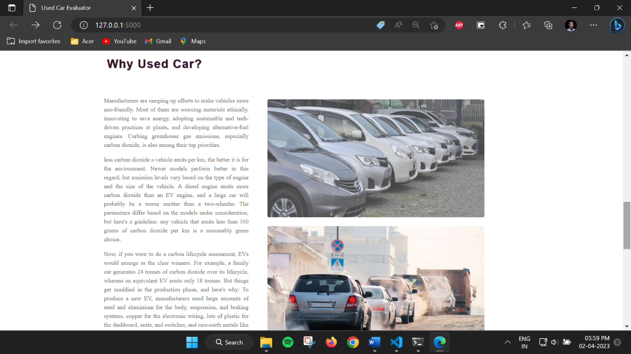

Slide 32
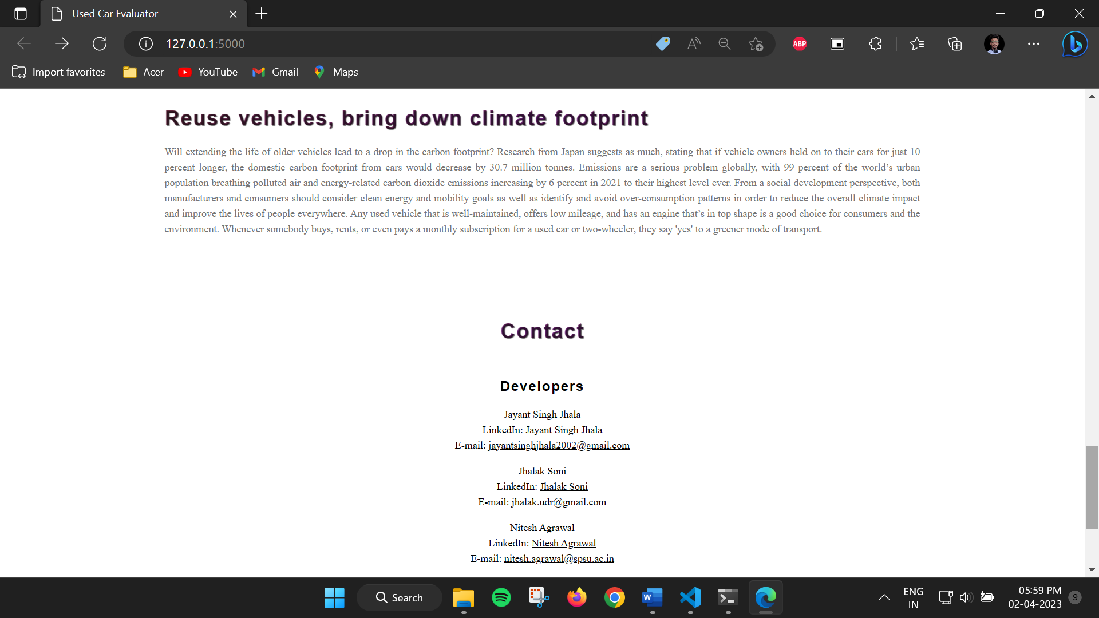

Slide 33
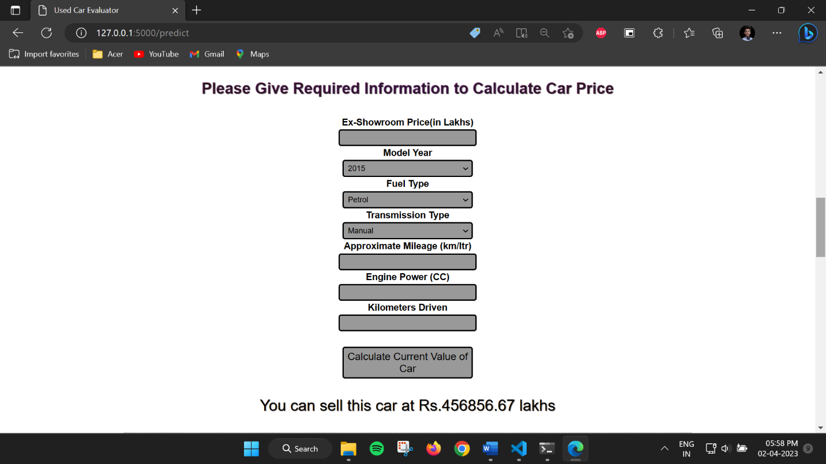
6.1. Sample Run

Slide 34
7. Result
The primary objective of the project is to deliver the accuracy while building reliable system using machine learning to predict used car prices. The research uses Random Forest Regression for this purpose. The R Squared value of the model is found out to be 0.9370041, the Mean Absolute Error is 102222.22 and RMSE is 262146.59.

Slide 35
8. Conclusion
The proposed system of Used Car Price Evaluator provides better predictions to dealers and individuals seeking to buy or sell their old car in India. The devised model implementation has provided with a reliable performance of Random Forest Regression model to predict used car prices. The car price has a strong dependence on its variety of factors or attributes, and it helps to yield forecast accuracy for used car prices. The results of the previous research study show that the Random Forest Regression method has performed significantly more than the rest of the methods, which makes the model to be employed for price prediction.

Slide 36
9. Future Scope
This web-based system namely “Used Car Price Evaluator” is restricted to the implementation using Random Forest Regression only, therefore allowing the room for improvement that can be achieved by employing ensemble machine learning in future developments of the proposed system .The system provides a static prediction of the price thus it can be extended to details regarding the yearly depreciation in the car price for better understanding of user.

Slide 37
10. Acknowledgement
It gives us immense pleasure in presenting the preliminary project report on ‘Used Car Price Evaluator’. We would like to take this opportunity to thank our internal guide Assist. Prof. Dr. Vishan Kumar Gupta for giving us all the help and guidance we needed. We are really grateful to her for all kind of support. His valuable suggestions were very helpful. In the end we are also grateful to Prof. Dr. Darpan Anand, Department of Computer Science Engineering, for his indispensable suggestions.

Slide 38
11.References
[1] N. Pal, P. Arora, D. Sundararaman, P. Kohli, and S. S. Palakurthy, “How much is my car worth? A methodology for predicting used cars prices using Random Forest.” [Online]. Available: www.pakwheels.com
[2] M. Ahtesham and J. Zulfiqar, “Used Car Price Prediction with Pyspark,” in Lecture Notes in Networks and Systems, Springer Science and Business Media Deutschland GmbH, 2022, pp. 169–179. doi: 10.1007/978-3-031-01942-5_17.
[3] “Predicting True Value of Used Car using Multiple Linear Regression Model,” International Journal of Recent Technology and Engineering, vol. 8, no. 5S, pp. 42–45, Feb. 2020, doi: 10.35940/ijrte.e1010.0285s20.
[4] C. K. Puteri and L. N. Safitri, “Analysis of linear regression on used car sales in Indonesia,” in Journal of Physics: Conference Series, Institute of Physics Publishing, Feb. 2020. doi: 10.1088/1742-6596/1469/1/012143.

